Slide 1
CQT
QUANTUM OPTICS
GROUP
Entanglement-based Free Space
Quantum Cryptography in Full Daylight
Ilja Gerhardt, Matthew P. Peloso, Caleb Ho,
Antía Lamas-Linares and Christian Kurtsiefer

Slide 2
Introduction to QKD
Quantum Cryptography =
Quantum Key Distribution
Have a Random Number at two locations
One-time pad for encryption
1980ies: Prepare and Send
Bennet Brassard, BB84
Send single Photons, non-cloning theorem
1990ies: Entanglement Based… why?

Slide 3
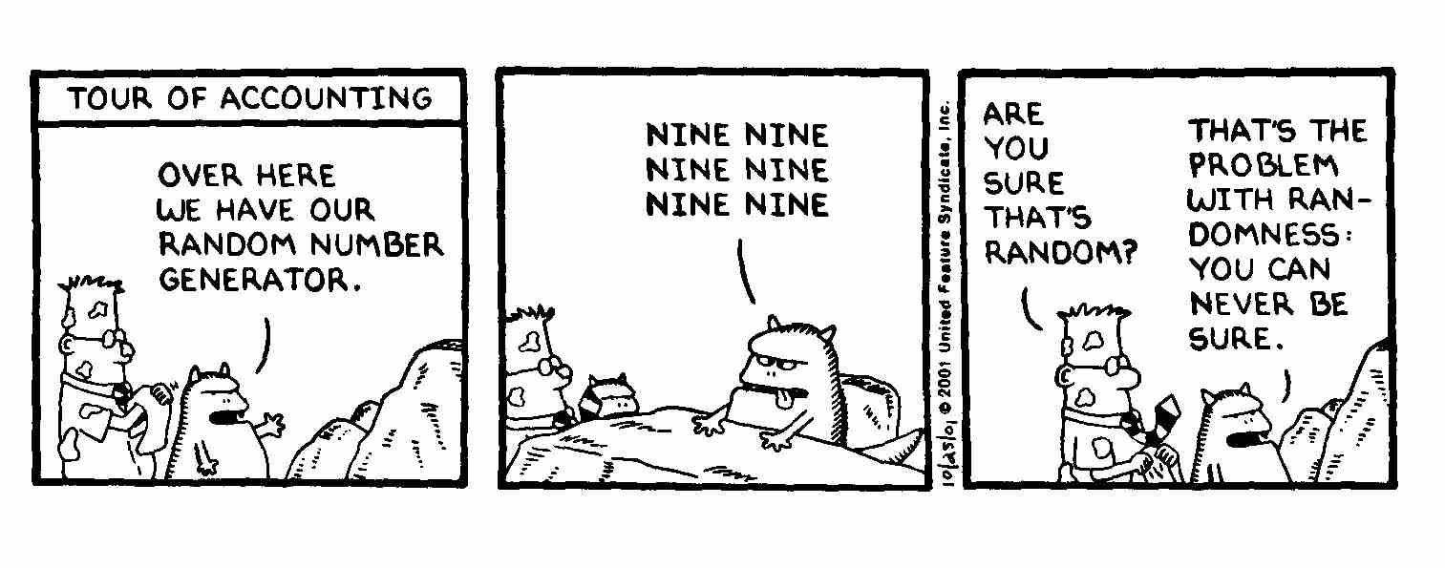
Prepare and Send
Need for Random Numbers
Different Photons, different Colors?
Dimensionality of Hilbert space needs to be known for security
Notes:
Why entanglement based

Slide 4
Entanglement based QKD
Ekert 1991 (E91)
Let’s measure two qubits of an entangled entity
Perfect (Anti)correlation
Bell’s inequality violated
= eavesdropper knowledge can be eliminated via PA
Photons for convenience…
Freespace: Ad-hoc set-up
Notes:
Bell inequality violated = a wittness which is independent of the size of the Hilbert space

Slide 5
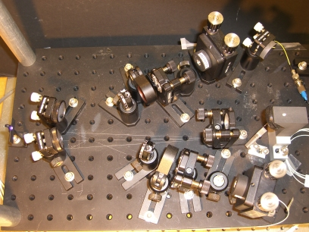
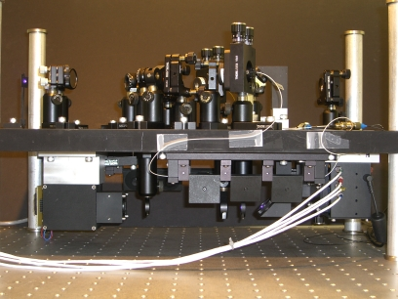
Entanglement based QKD
Pairsource: BBO, lean & compact
Strong temporally correlated ☺
Broader than dimmed lasers ☹
10’’
19’’

Slide 6
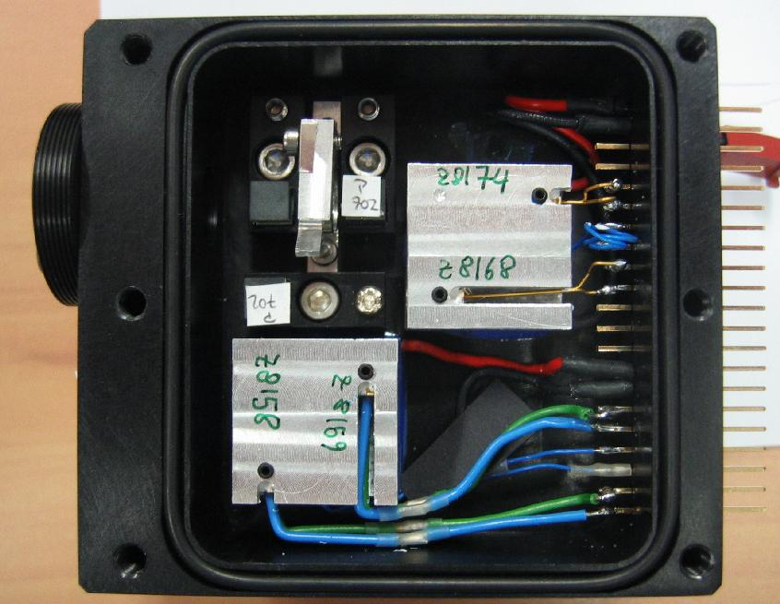
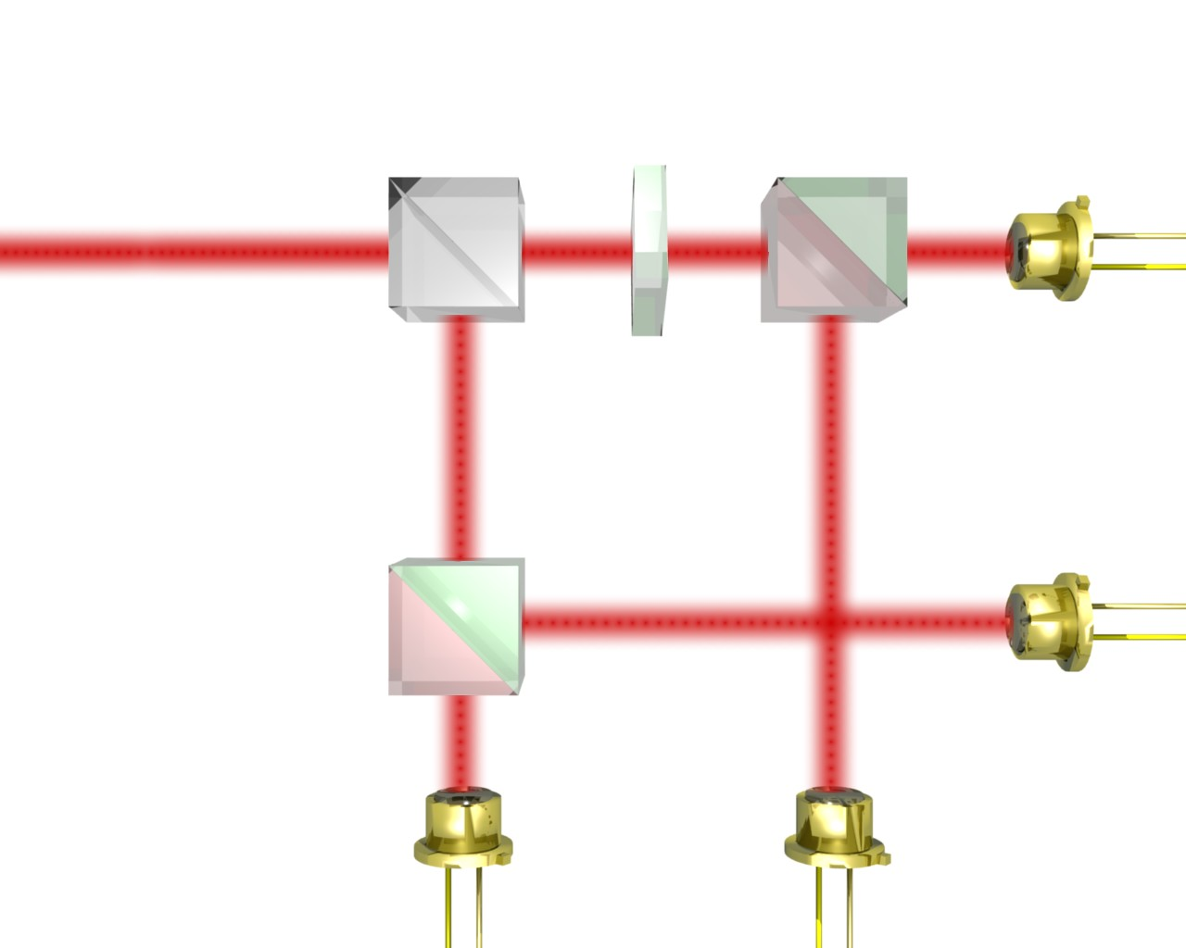
Detection of Photons
Detection: Polarization analyzer
λ/2
22.5°
PBS
50:50
APD,
+45°
PBS
V
H
-45°
J.G. Rarity et al., J. Mod. Opt. 41, 2345 (1994)‏

Slide 7
Setup
M. Peloso et al., New J. Phys. 11 045007 (2009)
Notes:
Timing! How to find coincidences
Why freespace
Night time easy

Slide 8
Problems in Daylight
Destruction of detectors
Non-linearity of the detector
Saturation
Accidental clicks
Confused with real coincidence events (QBER)
Fluctuations of ~30dB (day/night)
M. Peloso et al., New J. Phys. 11 045007 (2009)

Slide 9
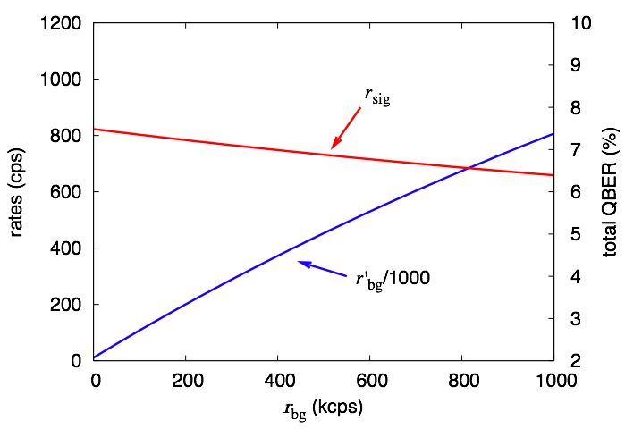
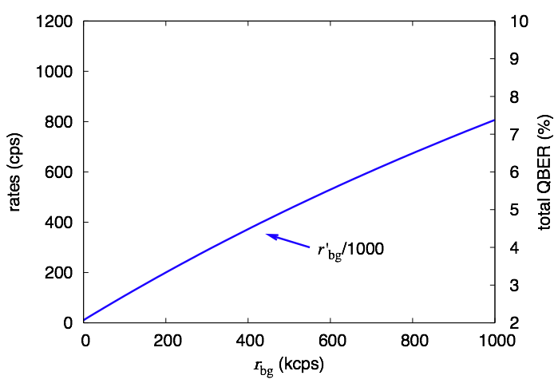
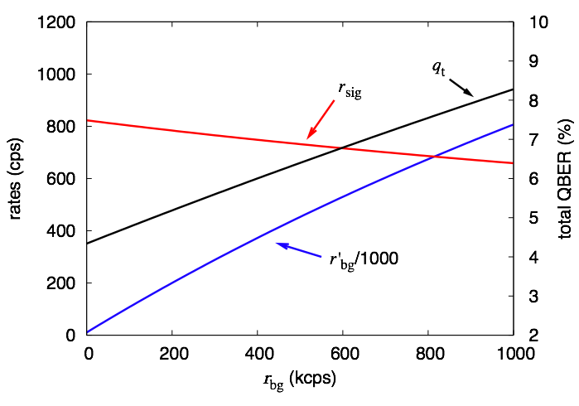
Expected Rates at daylight
M. Peloso et al., New J. Phys. 11 045007 (2009)

Slide 10
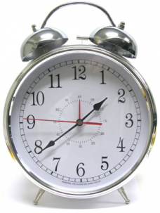
Sun & Solutions
6.7nm
-12 dB
- 3-4 dB
100µrad
FOV=10cm
Δt=1ns
M. Peloso et al., New J. Phys. 11 045007 (2009)

Slide 11
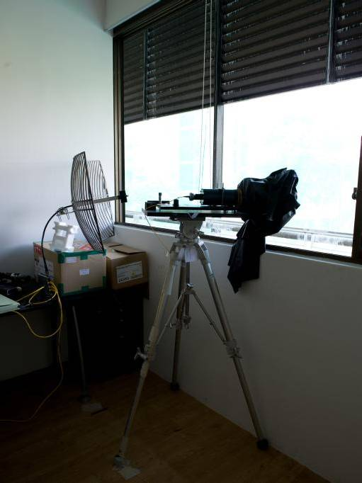
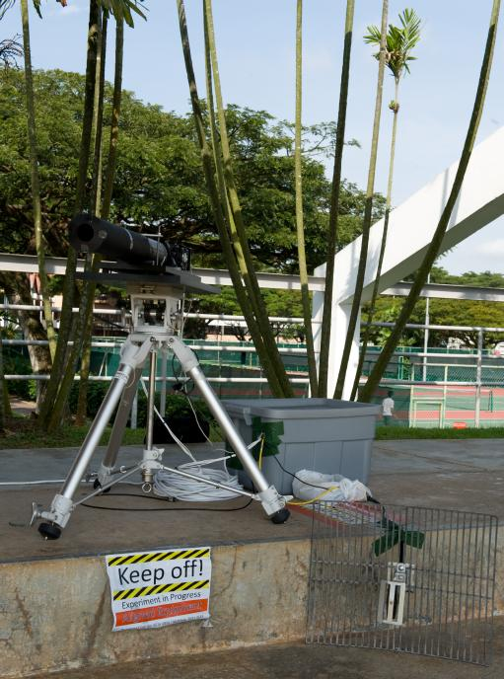
Setup
Alice
Bob
M. Peloso et al., New J. Phys. 11 045007 (2009)

Slide 12
Measured rates at daylight
Sync possible at daylight
M. Peloso et al., New J. Phys. 11 045007 (2009)

Slide 13
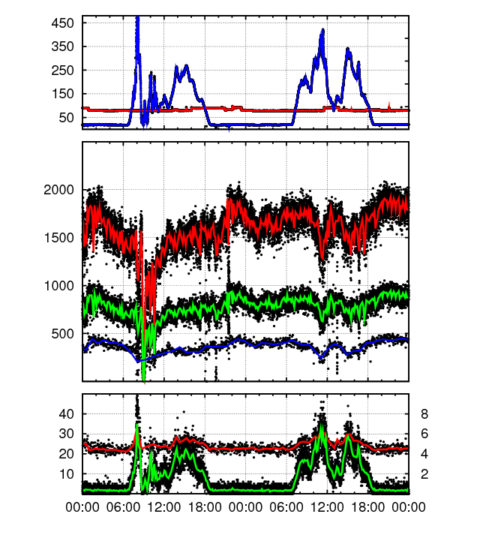
Experimental results
total detection rate at receiver (kcps)‏
total 'local' detector rate at source (kcps)‏
coincidences (cps)‏
raw key rate (s⁻¹)‏
key rate after error correction (s⁻¹)‏
accidental
coincidence
rate r_{a} (cps)‏
QBER (%)‏
M. Peloso et al., New J. Phys. 11 045007 (2009)

Slide 14
Conclusions
Entanglement based QKD in daylight,
4 days run without interruption
Synchronization works at ambient conditions
Noise Suppression
Spectral
Temporal
Spatial
Brighter Sources…70 pairs/(s mW MHz)
M. Peloso et al., New J. Phys. 11 045007 (2009)

Slide 15
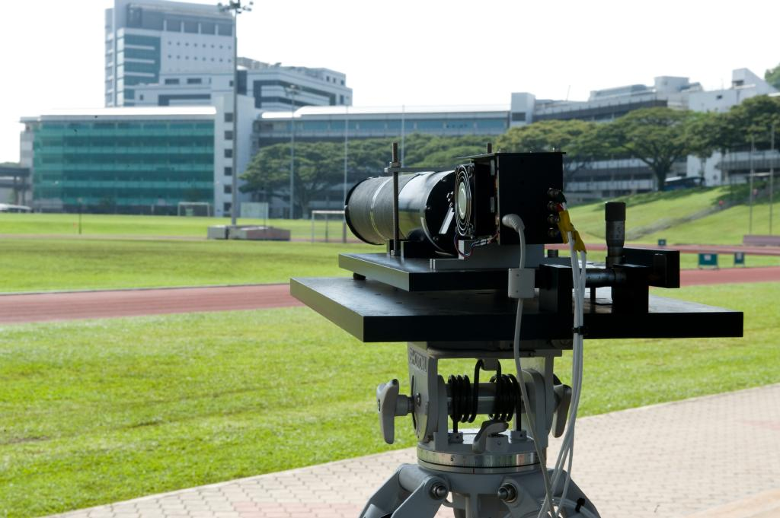
Thanks for your attention
http://qolah.org

